Slide 1
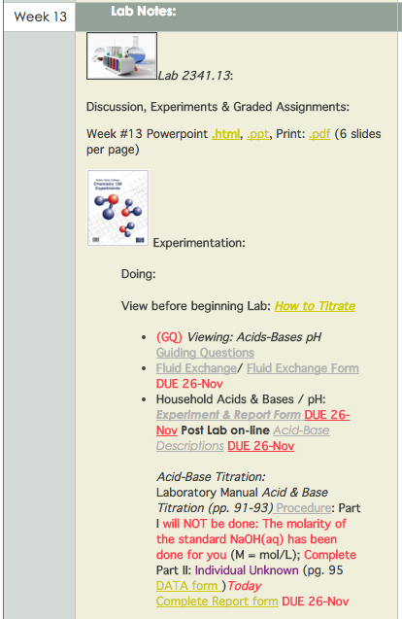
Chem 108: Lab
Week 13
Sign in / Pick up Papers
Pick a vial and a plastic dropper
Using the vial number, sign-in next to your name on the Lab roster

Slide 2
Chem 108: Class/ Lab
Week 13
TODAY:
Fluid Exchange
(Handout) Due Next Lab
2) To Do: Acid-Base Equilibrium Experiment
(Handout)
Data completed & signed before leaving Lab
3) To Do: Unknown acid titration
Data completed & signed before leaving Lab
Follow Instructions
http://chemconnections.org/general/chem120/fluid-ex.108.html

Slide 3
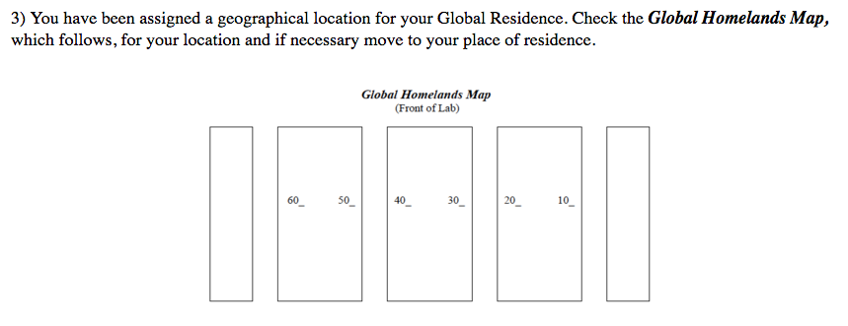
Chem 108: Class/ Lab
Week 13
TODAY:
Fluid Exchange (Handout)
http://chemconnections.org/general/chem120/fluid-ex.108.html
Wait for Dr. R's instructions on exchanging fluids, keeping records, and using the forms provided.

Slide 4
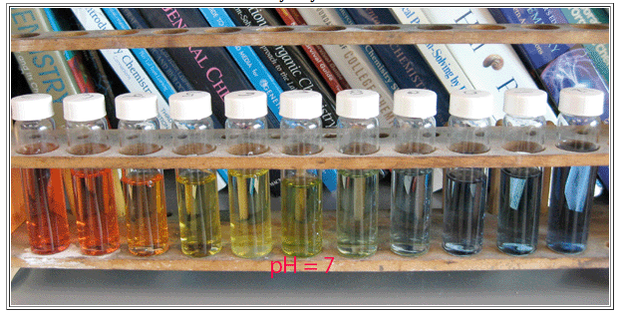
Acid-Base Indicators
<7 ACIDIC
Neutral
>7 BASIC

Slide 5
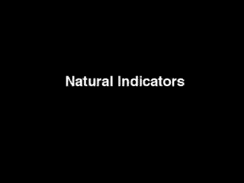
Indicators

Slide 6
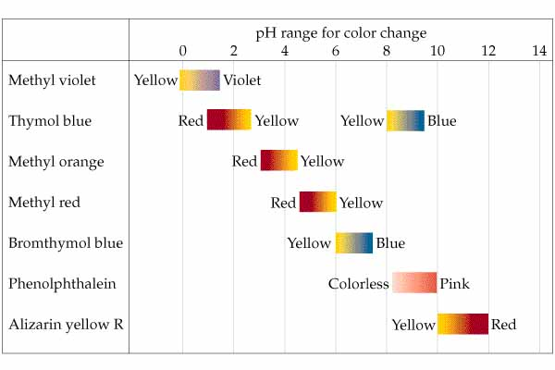
Acid-Base Indicators

Slide 7
Chem 108: Class/ Lab
Week 13
Fluid Exchange
(Handout) Due Next Lab
TODAY:
2) To Do: Acid-Base Equilibrium Experiment
(Handout)
Data table completed & signed before leaving Lab
Fully Completed Handout Due Next Week

Slide 8
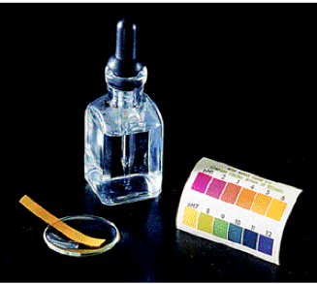
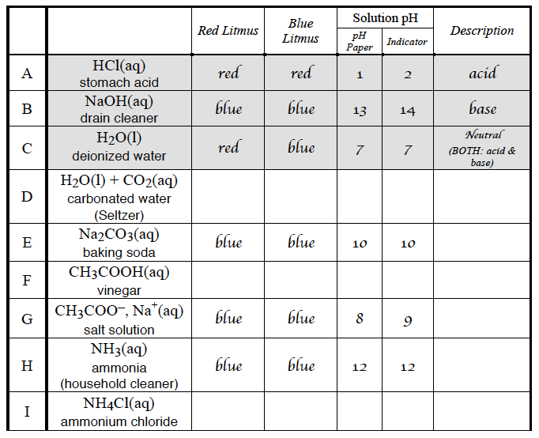
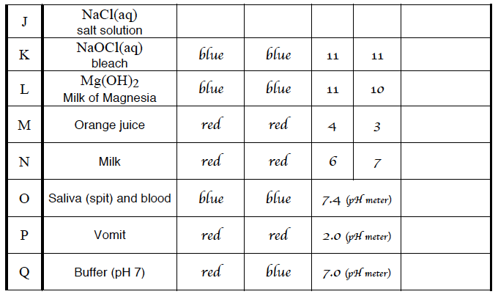
Lab: universal Indicator, litmus & pH paper

Slide 9
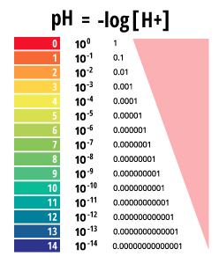

Slide 10
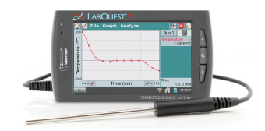
Lab pH: pH Meter (Chem 120)
1.0
13.0
7.0
6.4
10.1
4.7
8.4
12.0
6.1
7.0
10.9
12.2
3.8
6.4
7.3
1.9
7.0

Slide 11
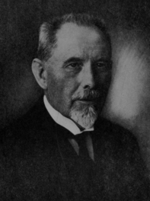
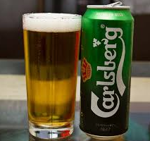
The pH Scale
https://phet.colorado.edu/en/simulation/ph-scale-basics
pH: the negative logarithm
of the
hydrogen ion concentration.
Quantitative, logarithmic, numeric scale based on testing the electric current of aqueous solutions & relating it to the equilibrium concentration of the hydrogen ion,
[H⁺_{(aq)} ]= [H₃O⁺_{(aq)}]
Introduced in 1909 by Søren Sørensen, Danish brewer/chemist, as a convenient way of expressing acidity……. Providing much improved quality control in brewing.
Beer’s pH ~ 4
http://www.chemconnections.org/general/chem108/Acids-Bases%20Guide.html

Slide 12
Chem 108: Class/ Lab
Week 13
Fluid Exchange
(Handout) Due Next Lab
2) To Do: Acid-Base Equilibrium Experiment
(Handout)
Data completed & signed before leaving Lab
TODAY:
3) To Do: Unknown acid titration
Data completed & signed before leaving Lab

Slide 13
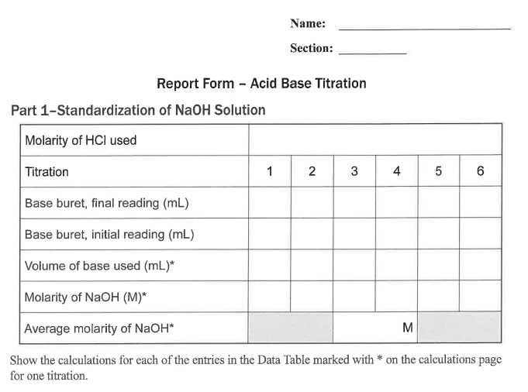
Chem 108: Lab
Standardization (Part 1) will not be done. Molarity of sodium hydroxide standard solution will be provided.
Individual Titrations of Unknown
Acid
To Do Today
Notes:
A 3900-year-old clay tablet, which was found in Iraq between the Tigris and Euphrates rivers, had a Sumerian poem (http://www.piney.com/BabNinkasi.html) honoring Ninkasi, the patron goddess of brewing. It contains the oldest surviving beer recipe, describing the fermentation of the carbohydrates found in bread, bappir, made from barley, honey, dates and sweet aromatic herbs. The global availability of carbohydrates and native microbes (yeasts) has led to the production of many different types of beers, ales, wines, and fruit based alcoholic beverages in many countries throughout the world. [The bottle on the left was found in Eugene, Oregon, ……. But, it dates only to 2016.]

Slide 14
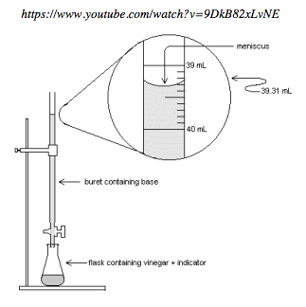
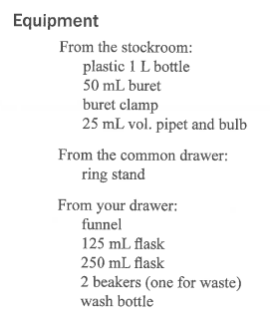
https://www.youtube.com/watch?v=9DkB82xLvNE
Acid-Base Titration
Part 2: Unknown Acid

Slide 15
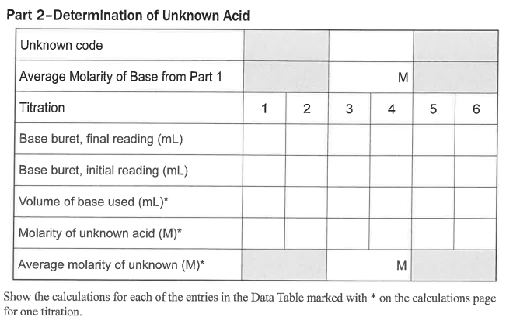
Chem 108: Lab
Part 2:
To Do (individually) today.
Have signed before leaving lab.
0.2051 mol/L
3 trials must be within
+/- 0.20 mL
Take a clean, dry, 125 mL erlenmeyer flask to the stockroom window and get unknown acid solution. Record unknown number. Have data page signed before leaving lab today.

Slide 16
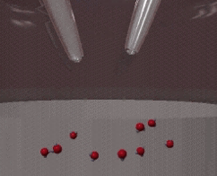
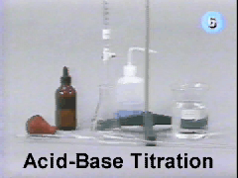
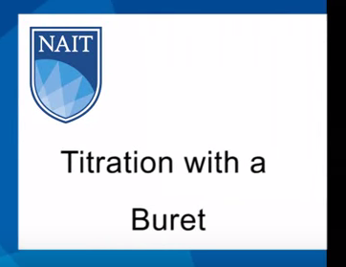
Neutralization Reactions
Titration
https://www.youtube.com/watch?v=9DkB82xLvNE
H⁺_{(aq)} + OH ⁻_{(aq)} H₂O_{(l)}

Slide 17
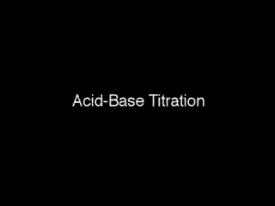
Neutralization Reactions
Titration
pH curves
Chem 120/121

Slide 18
Unkown Acid Neutralization
Net Ionic Equation/ Calculation
HNO_{3(aq)} + NaOH _{(aq)} NaNO₃ _{(aq)} + H₂O_{(l)}
acid
base
salt
water
conj. base
conj. acid
H⁺_{(aq)} + OH ⁻_{(aq)} H₂O_{(l)}
acid
base
water
  25.00 mL of M_{H+ (aq)}= ? (unknown monoprotic nitric acid solution) was titrated with a sodium hydroxide solution, M_{OH-}= ? 0.2162 M. It required 24.20 mL as an average of three trials which were within +/- 0.20 mL to reach a faint pink color.
  M_{H+ (aq)} = ?
?M_{H+} = [M_{OH-} x V_{OH-} / V_{H+} ] [? mol_{H+} / ? mol_{OH-}]

Slide 19
Unkown Acid Neutralization
Net Ionic Equation/ Calculation
H⁺_{(aq)} + OH ⁻_{(aq)} H₂O_{(l)}
acid
base
water
  25.00 mL of M_{H+ aq}= ? (unknown monoprotic acid solution) was titrated with a sodium hydroxide solution, M_{OH-}= ? 0.2162 M. It required 24.20 mL as an average of three trials which were within +/- 0.20 mL to reach a faint pink color.
?M_{H+} = [M_{OH-} x V_{OH-} / V_{H+} ] [? mol_{H+} / ? mol_{OH-}]
0.2162 mol_{OH-} x 0.02420 L_{OH-} x 1 mol_{H+}
L_{OH-} x 0.02500 L_{H+} x 1 mol_{OH-}
=
= 0.2093 M_{H+}

Slide 20
QUESTION
A 35.00 mL sample of a monoprotic acid of unknown concentration was titrated with 42.30 mL of 0.2250 M KOH. What is the concentration of the unknown acid?
0.0930 M
0.3030 M
0.2719 M
0.1356 M
0.3720 M
H⁺_{(aq)} + OH ⁻_{(aq)} H₂O_{(l)}
?M_{H+} = [M_{OH-} x V_{OH-} / V_{H+} ] [? mol_{H+} / ? mol_{OH-}]

Slide 21
QUESTION
A 35.00 mL sample of sulfuric acid (a di-protic acid) of unknown concentration was titrated with 42.30 mL of 0.2250 M KOH. What is the concentration of the unknown acid?
0.0930 M
0.3030 M
0.2719 M
0.1356 M
0.3720 M
1
H₂SO₄
2
2
H⁺_{(aq)} + OH ⁻_{(aq)} H₂O_{(l)}
? M_{H+} = [M_{OH-} x V_{OH-} / V_{H+} ] [? mol_{H2SO4} / ? mol_{OH-}]

Slide 22
Chem 108: Lab
Part 2: Week 13
To Do (individually) today
0.2051 mol/L
Take a clean, dry, 125 mL erlenmeyer flask to the stockroom window and get unknown acid solution. Record unknown number. Have data page signed before leaving lab today.

